Slide 1
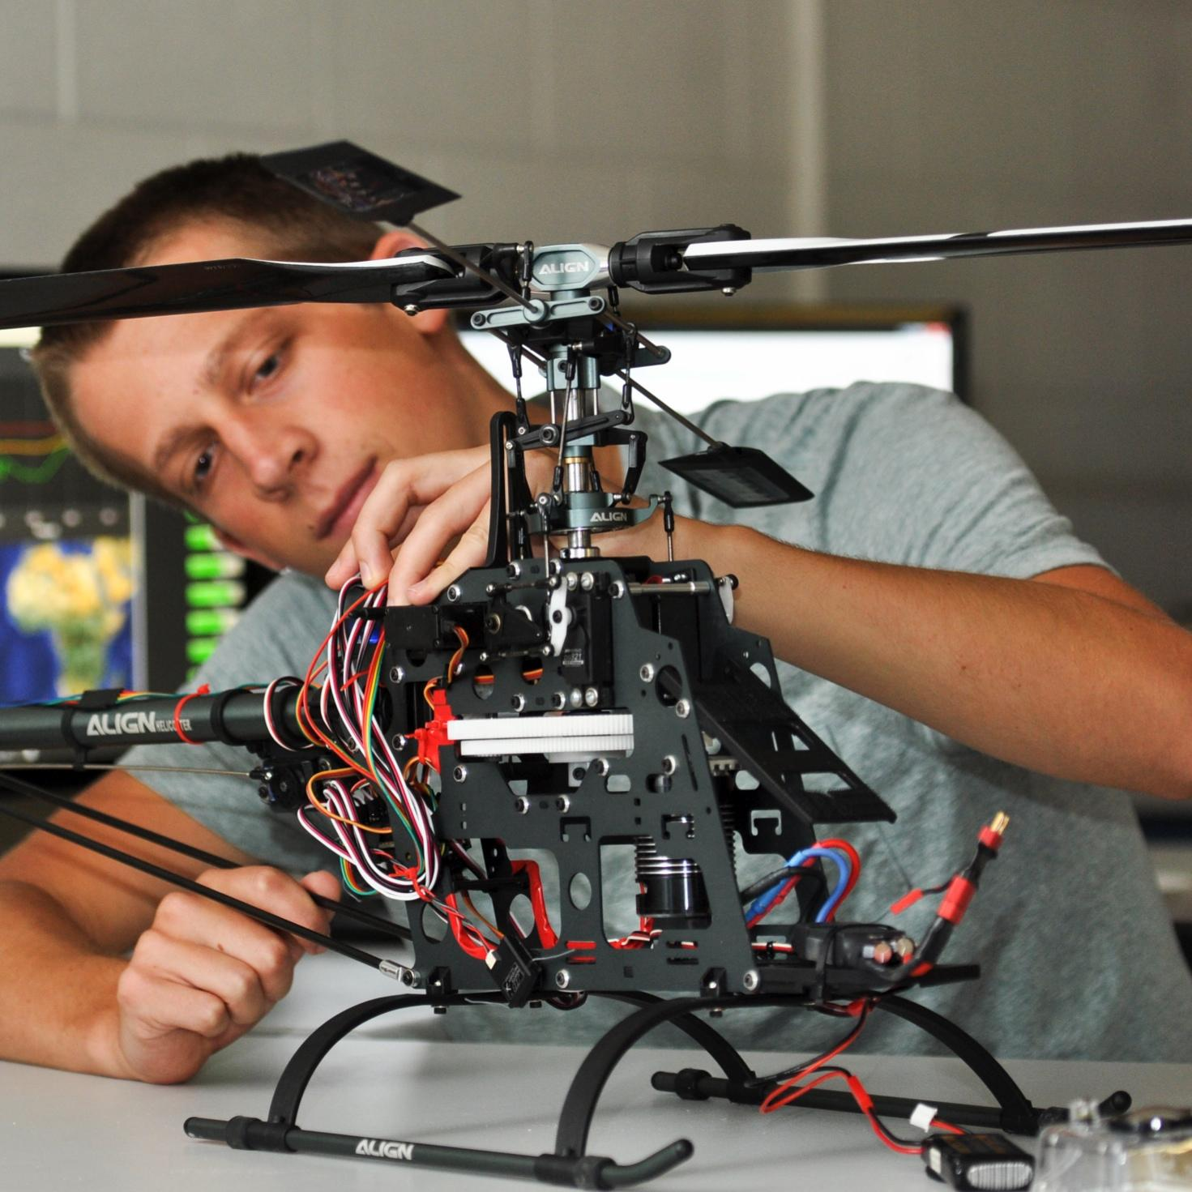

ECEN 403
Power & Analog Filters
DEMO
Team #25: The Only WGT
Team Member: Salina Teng
TA: Jianhan Pan
Sponsor: John Lusher
Notes:
Hi, My name is Salina and I’m in charge of the power and analog filter subsystems.

Slide 2
Power Subsystem
Salina Teng
Design
Test
Create a stable, low-noise multi-rail power design for the AWG
Verify converter startup behavior, rail stability, and load performance
Defined +12V → ±10V, +5V, +3.3V, +3.3V_CLEAN
rails on schematic/PCB
Added input protection & filters
Selected the proper DC/DC converters for all rails
Added precision VREF IC for clean DAC reference
Simulated transient/steady-state rail performance in LTspice
Measured rail voltage and startup behavior
Performed load-step and Vin-step tests on all rails
Confirmed voltage rail accuracy (±2% tolerance)
Notes:
I will be presenting the power subsystem first. The power system is designed to output a +3.3V to the main digital loads, a filtered +3.3V to the DAC VDD, a +5V to the DAC VREF, and a +-10V to the analog output stage. Input protections were added to protect against reverse polarity, overcurrent, and voltage spikes. Small filters were also used throughout the system for high frequency noise filtering. For testing, I simulated transient and steady-state behavior in LTspice, then measured startup, and overall validated their performance across the full +-10% input voltage range and varying the load . All rails held accurate voltage within +-2% tolerance and stayed stable for over 15 minutes at max load.

Slide 3
Power Rail Specifications
Power Rail | Description | Maximum Expected Current Output | Required Resistor for Full-Load Test | Min Power Dissipated
+3.3V | Main Digital Load (FPGA/MCU) | 1.26 A (0.5 A headroom) | 2.62 Ω | 4.16 W
+3.3V_CLEAN | DAC VDD | Minimal (~ 5 µA) | Included in main +3.3V test | N/A
+5V | DAC VREF | 2 mA | 2.5 kΩ | 0.01 W
+10V | Analog Rail | 0.6 A (0.3 A headroom) | 16.7 Ω | 6 W
-10V | Analog Rail | 0.6 A (0.3 A headroom) | 16.7 Ω | 6 W
Notes:
This table shows all the power rails and the maximum expected current output for each rail. The resistors to be used for full-load test are as shown in the last column, and I will be presenting this full load test to demonstrate the performance of my power system.
The output voltage will be lower than desired if the wattage rating of the load resistor is too low.
This happens because the resistor's failure mechanism interferes with your power supply's ability to regulate the voltage

Slide 4
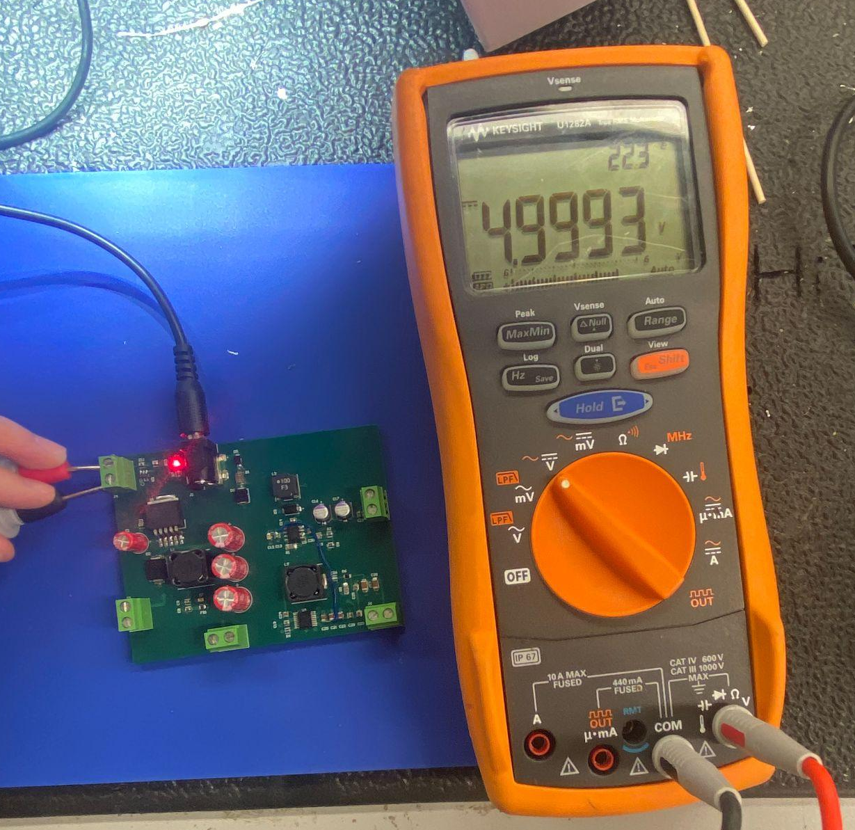
+5V Rail, No Load Test

Slide 5
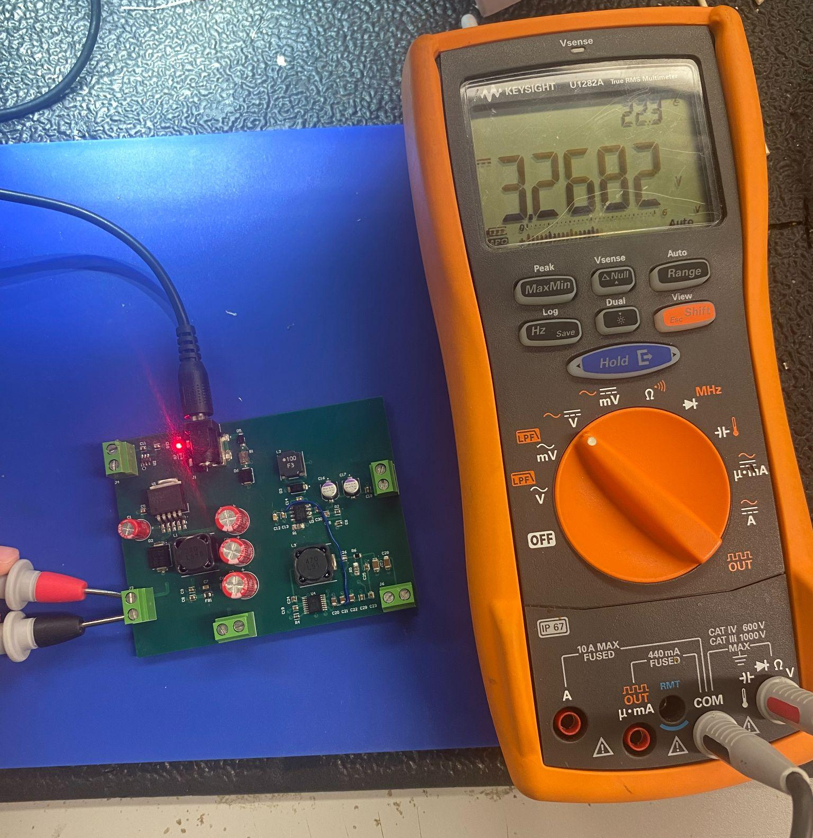
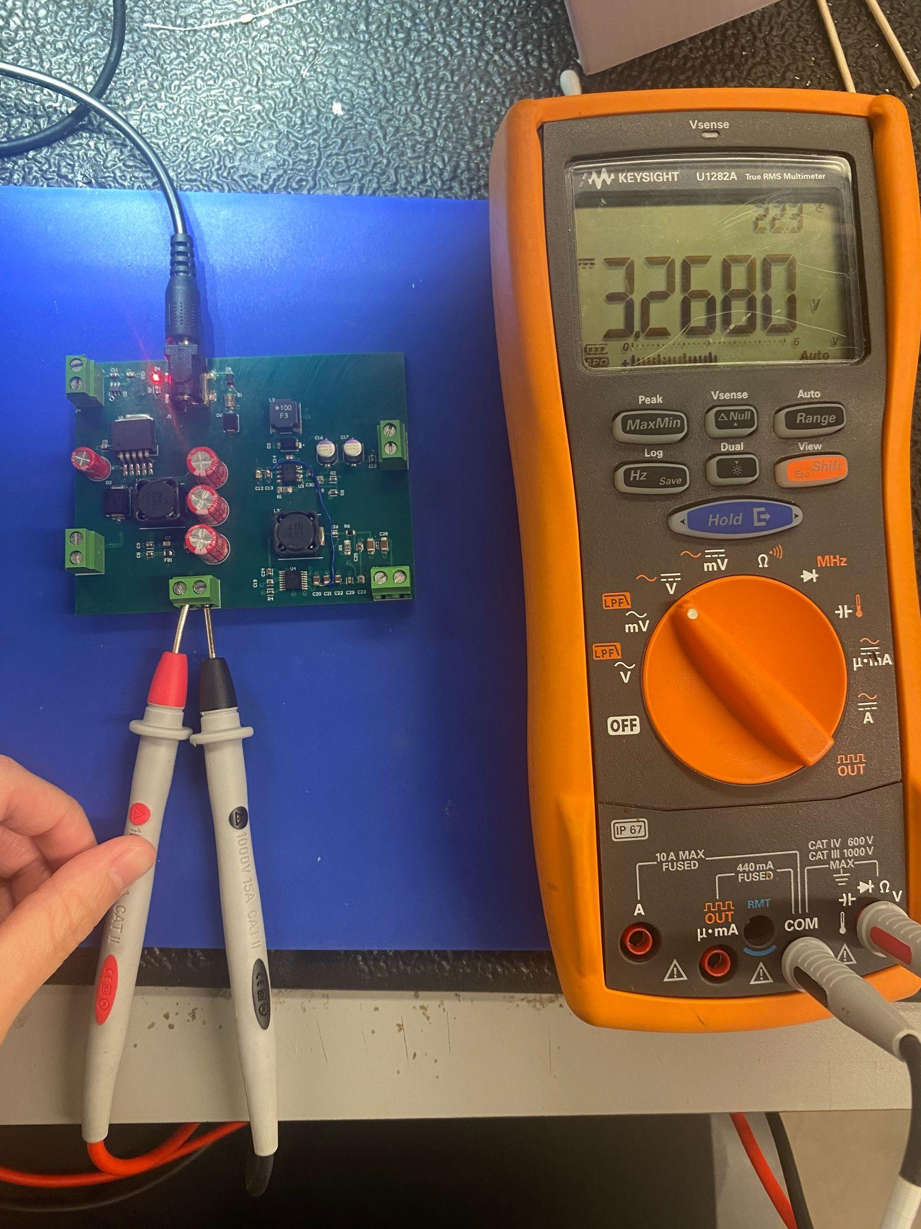
+3.3V Rail, No Load Test

Slide 6
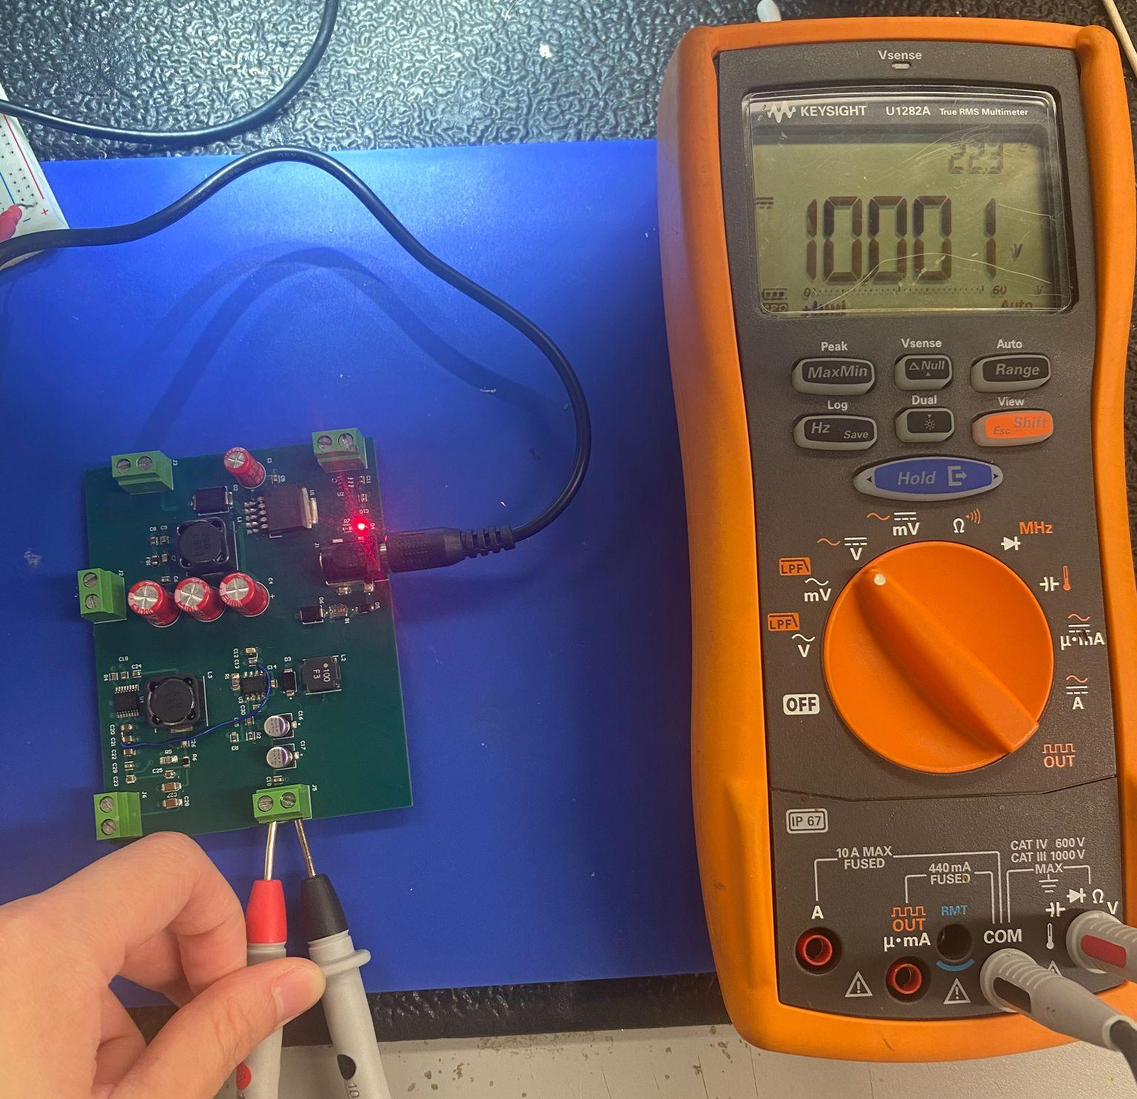
+10V Rail, No Load Test

Slide 7
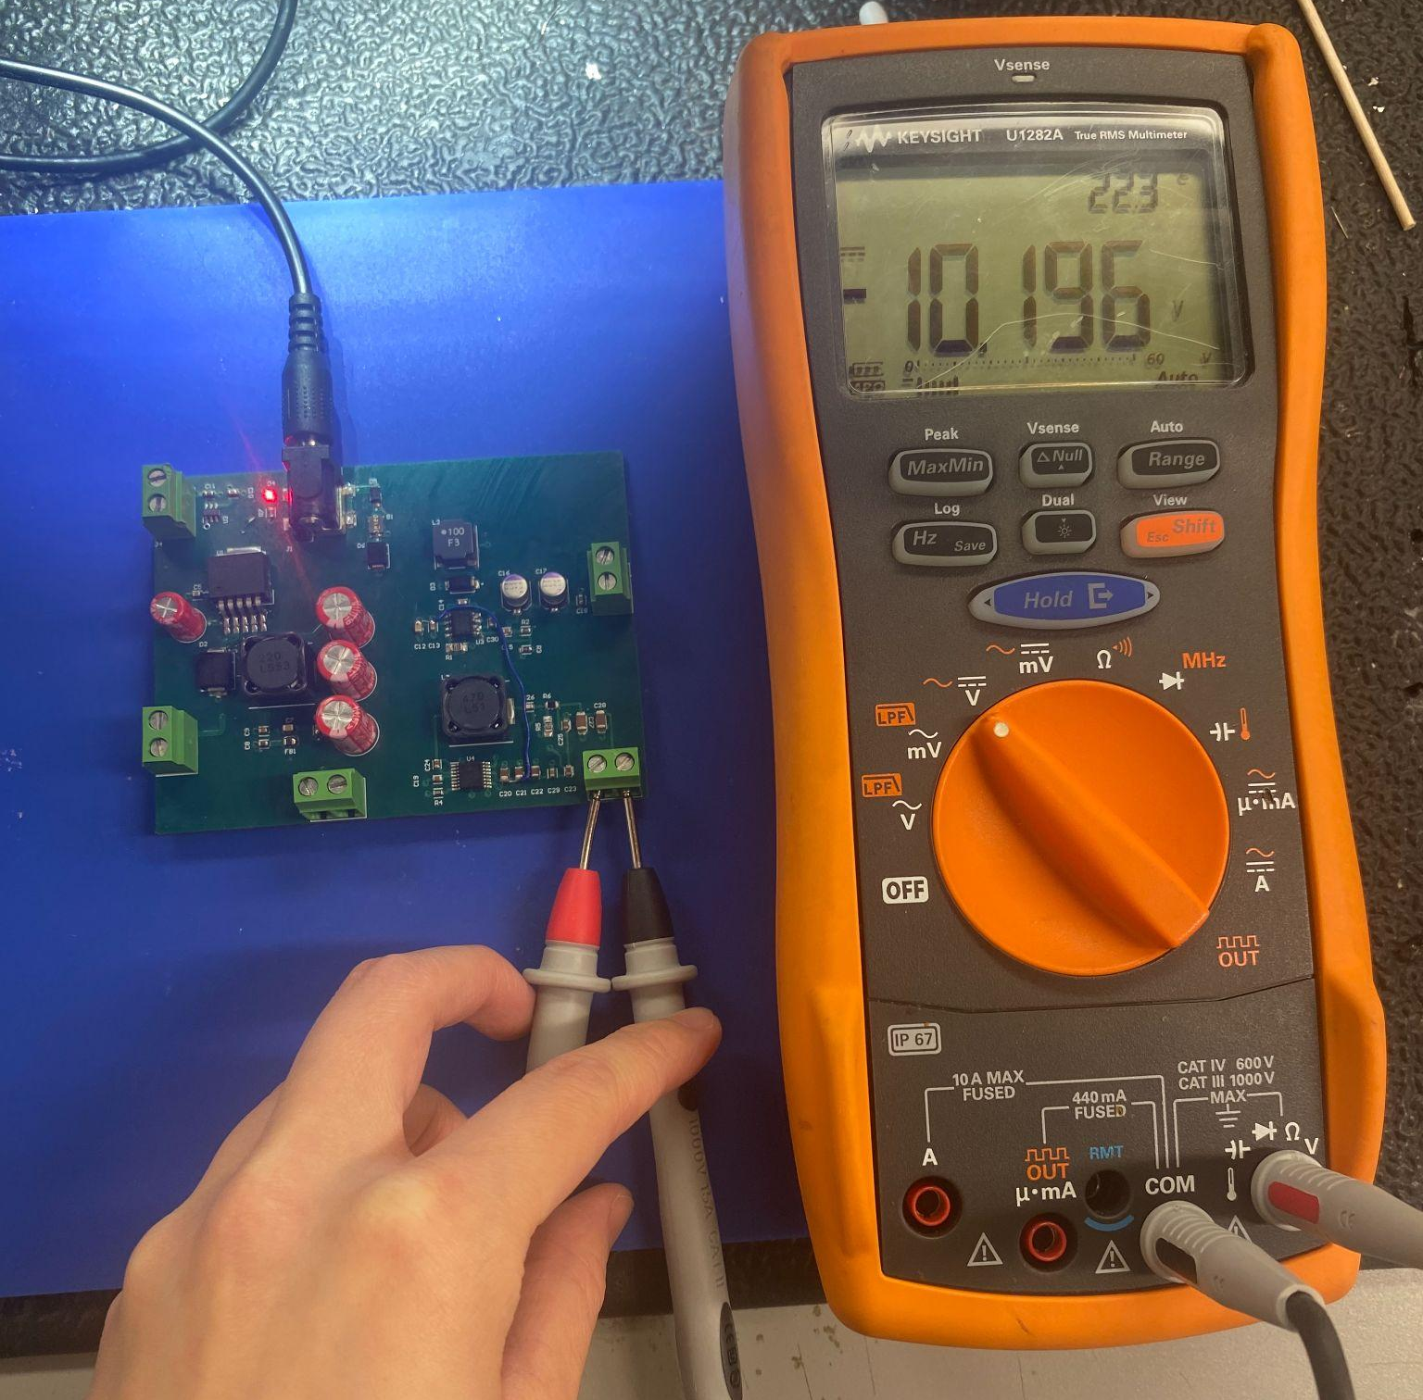
-10V Rail, No Load Test

Slide 8
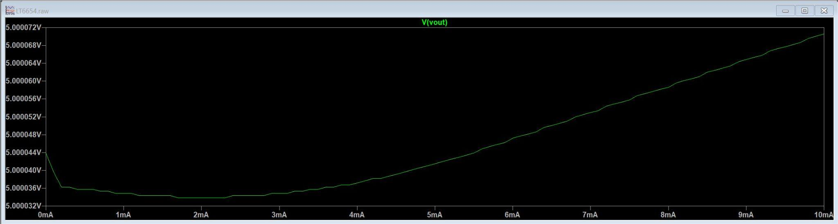
+5V Rail, Current Draw Test

Slide 9
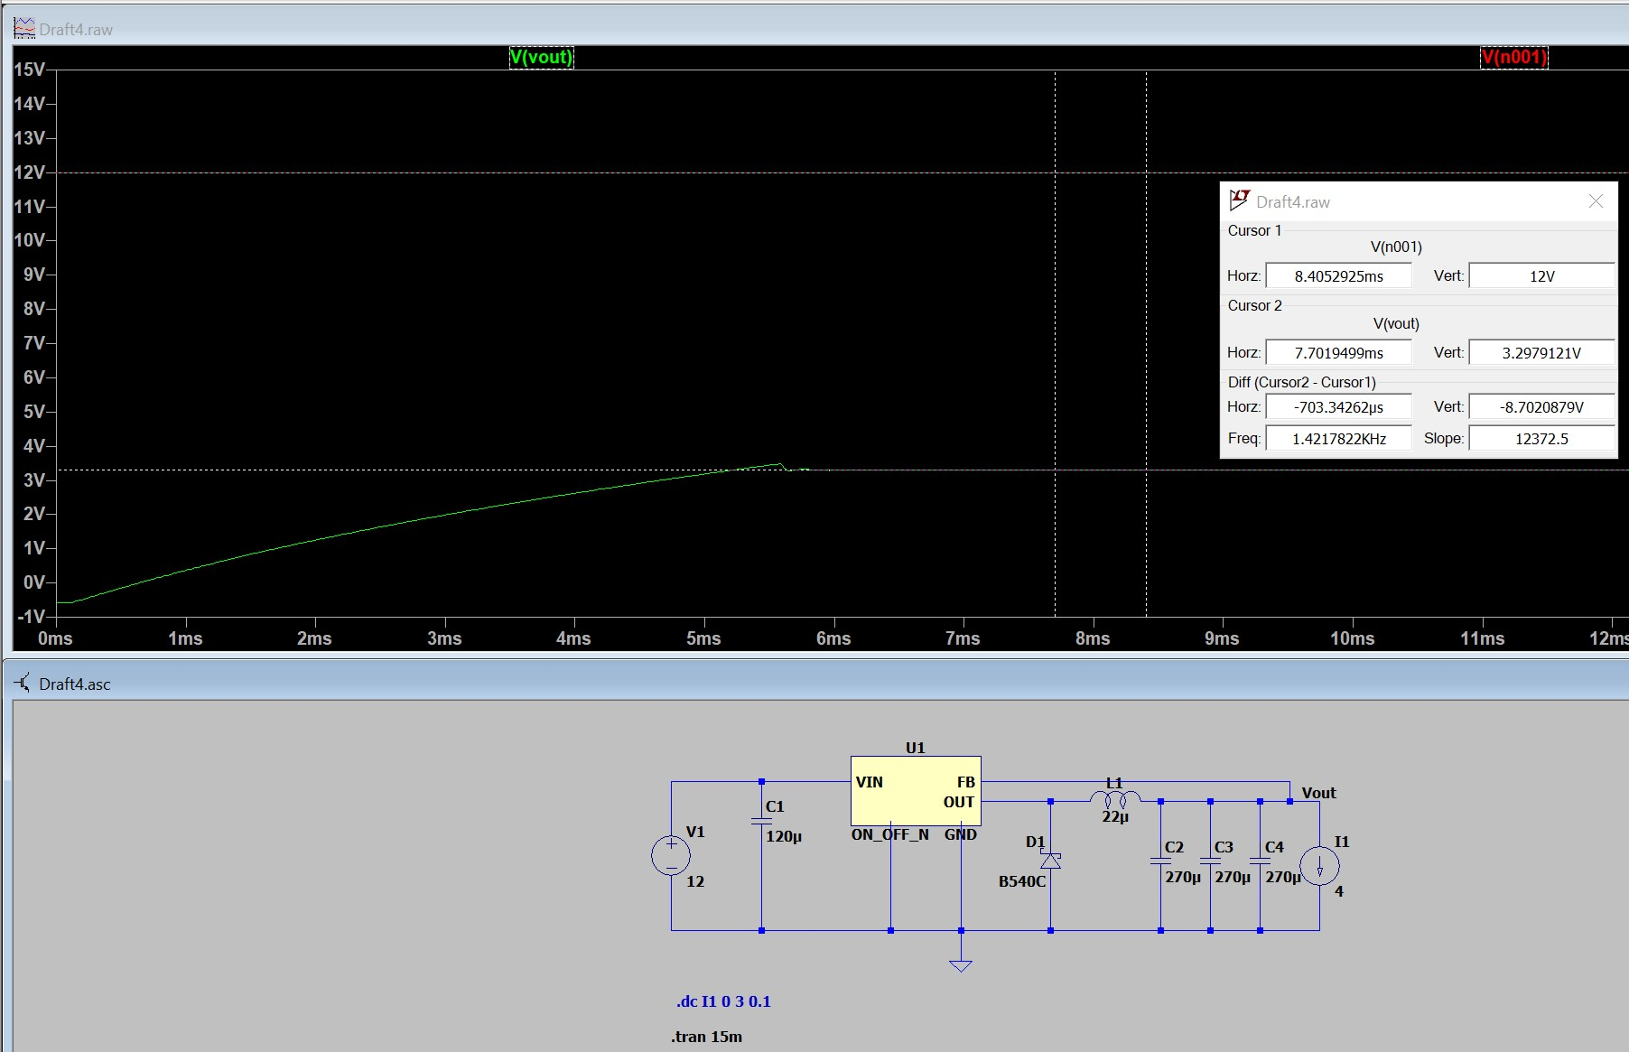
+3.3V Rail, 4A Current Draw Test

Slide 10
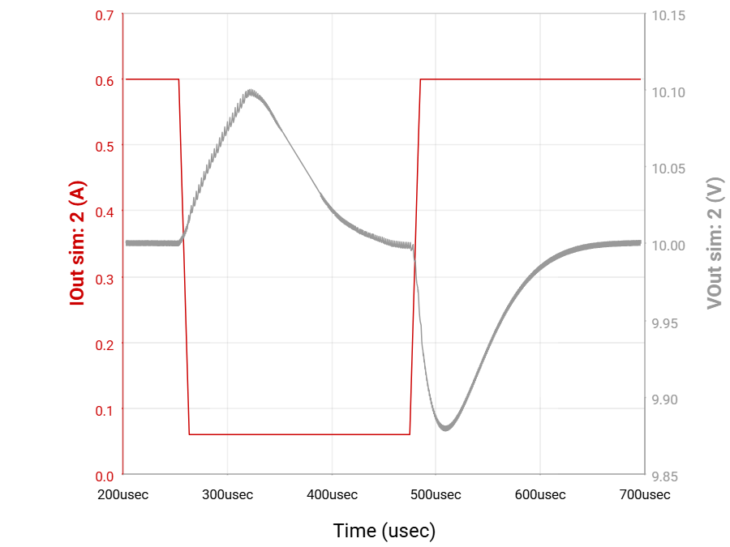
+10V Rail, Load Transient

Slide 11
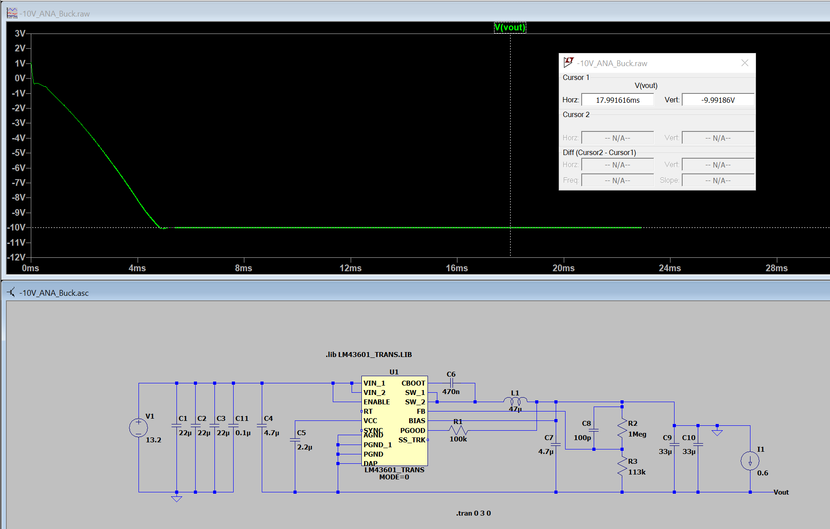
-10V Rail, 0.6A Current Draw Test

Slide 12
Analog Output Filters Subsystem
Salina Teng
Design
Test
Create a clean ±5V, 100 kHz analog output path for the AWG
Verify analog signal integrity and stage-to-stage performance
Defined DAC → I/V Converter → Low-pass →
Unity Gain Buffer design on schematic/PCB
Ensured ±10V rails support ±5V swing into 50 Ω at 100 kHz
Selected proper op-amps and passive component values to meet design specifications
Measured DAC → I/V Converter voltage value accuracy
Confirmed low-pass cutoff (150 kHz) and attenuation
Tested unity gain buffer output swing and load drive (50 Ω)
Verified full-chain output: ±5V, 50 Ω
Ensured stable operation on ±10V rails with minimal distortions
Notes:
My next subsystem is the Analog Output Filter subsystem. The purpose of this subsystem is to support up to a ±5V swing into 50 Ω at 100 kHz. I’ve ensured that the system can produce such signals when powered by the +-10V analog rails. For testing purposes, we are using ESP32’s to deliver the stream of 16-bit digital codes, which will transfer from the 22-pin connectors into the DAC to be outputted as current values, which will then go into the I/V to be outputted as voltage values that will go through the 150 kHz low-pass, and then the unity gain buffer. The final voltage signal is outputted through the BNC jack. I tested the I/V accuracy, filter response, and output swing under the 50 Ω load.
The full chain produced clean ±5V sine, sinc, and square waves with stable operation and minimal distortion. It should be noted that in 404, the FPGA will be used to deliver the 16-bit digital codes instead of the ESP32. The ESP32 has low sampling rate compared to the FPGA, causing signals at higher frequencies to be slightly stepped. I’ve confirmed this with our sponsor that this is not a system design issue, but just because we are limited by the ESP32. We will not be having this issue then we integrate this analog filter subsystem with the FPGA in 404.

Slide 13
Features
System supports both channels
Sine Wave
±5V, 1 Hz
Notes:
For today’s testing, we will produce +-5V 1kHz sine waves through both channels on this analog output filtering system.

Slide 14
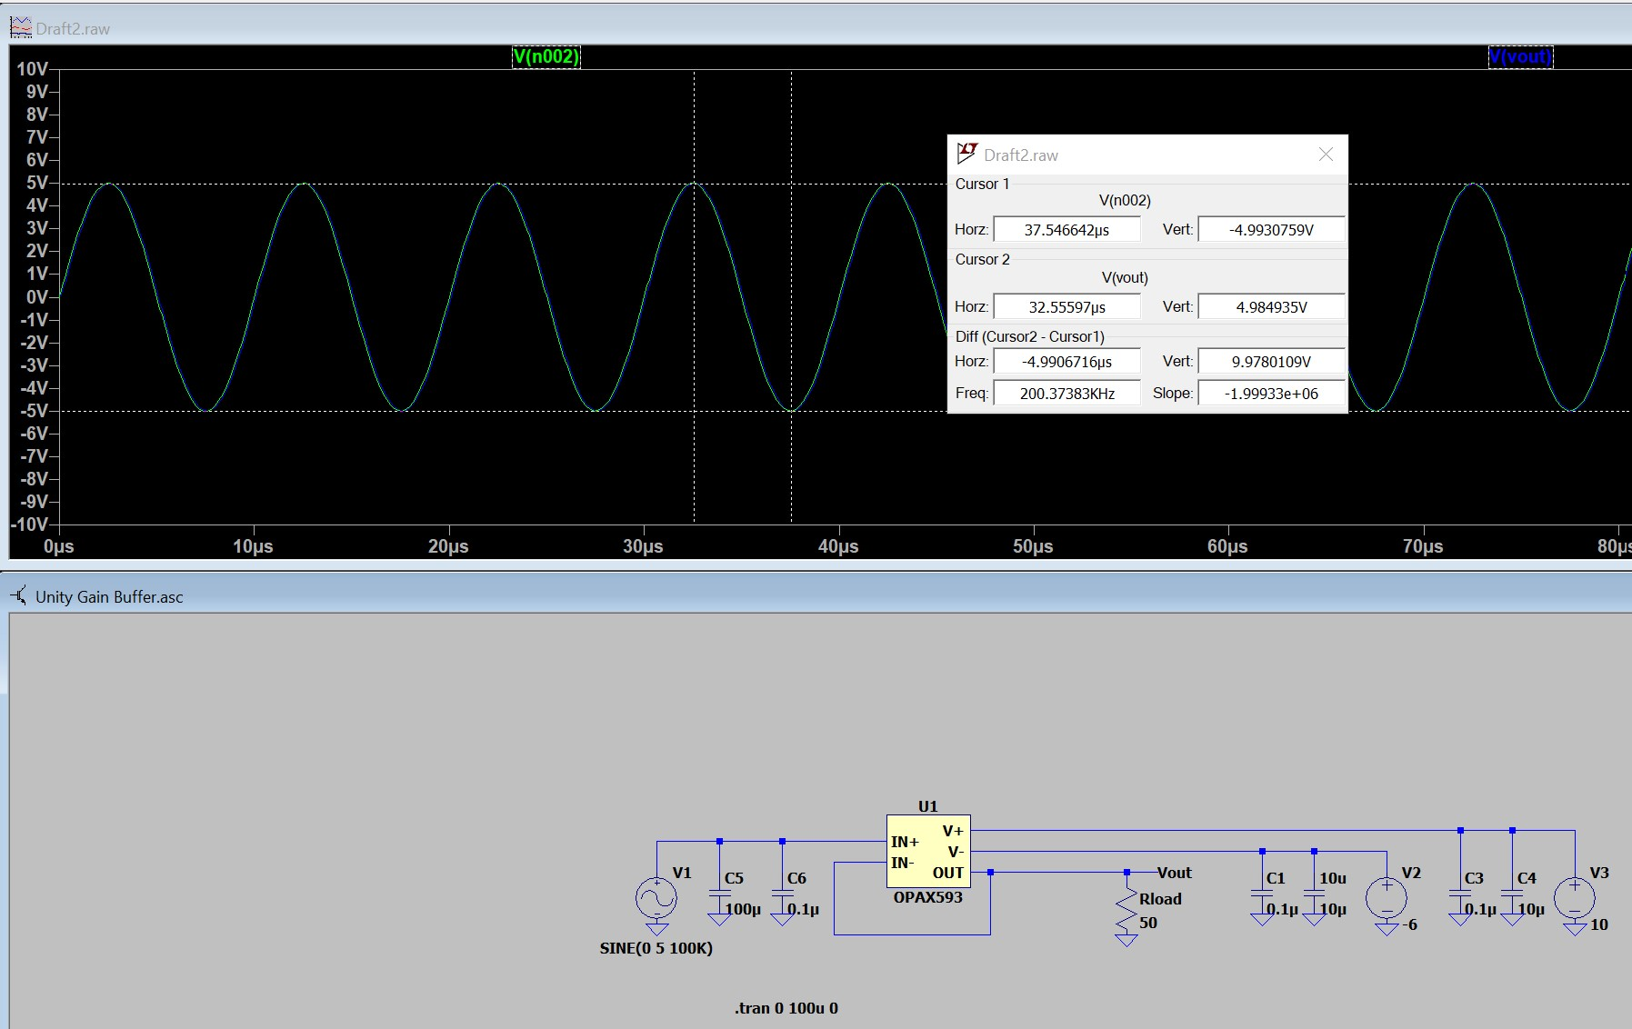
Output Buffer, ±5V swing into 50 Ω at 100 kHz
Notes:
unity gain buffer (or output amplifier) is the main driving force that allows your analog output stage to produce the +-5V, 100kHz signal into a 50 Ω impedance load

